Slide 1
PHP Project Base
Akshat Karambe

Slide 2
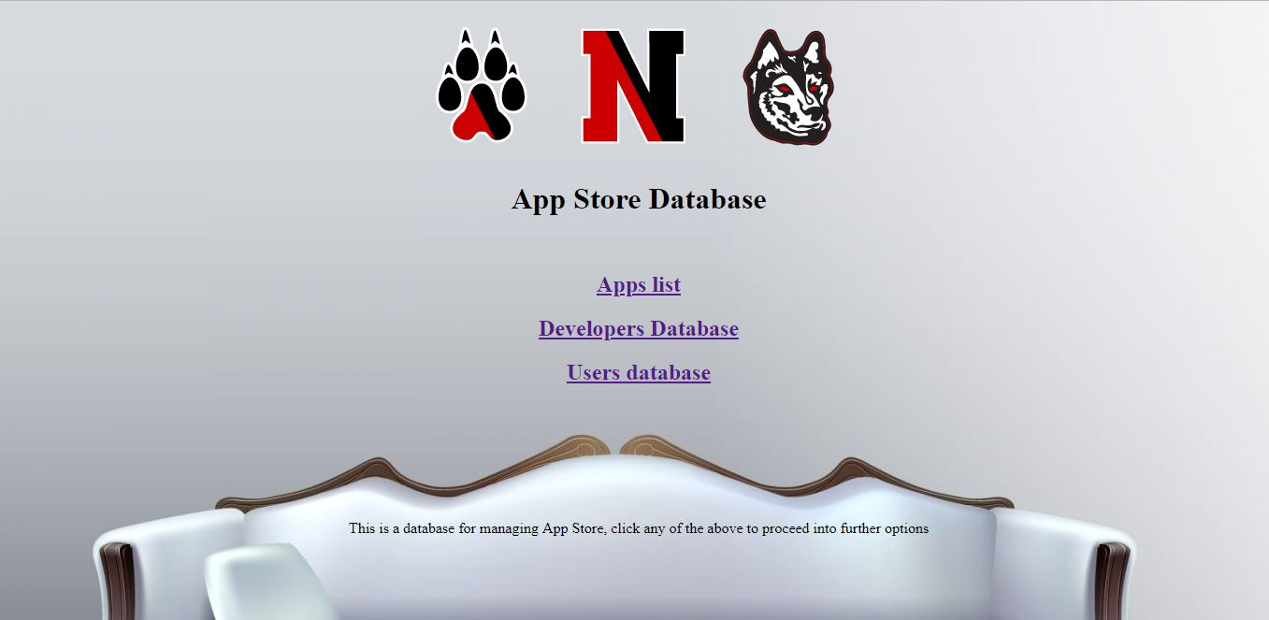
This the home page

Slide 3
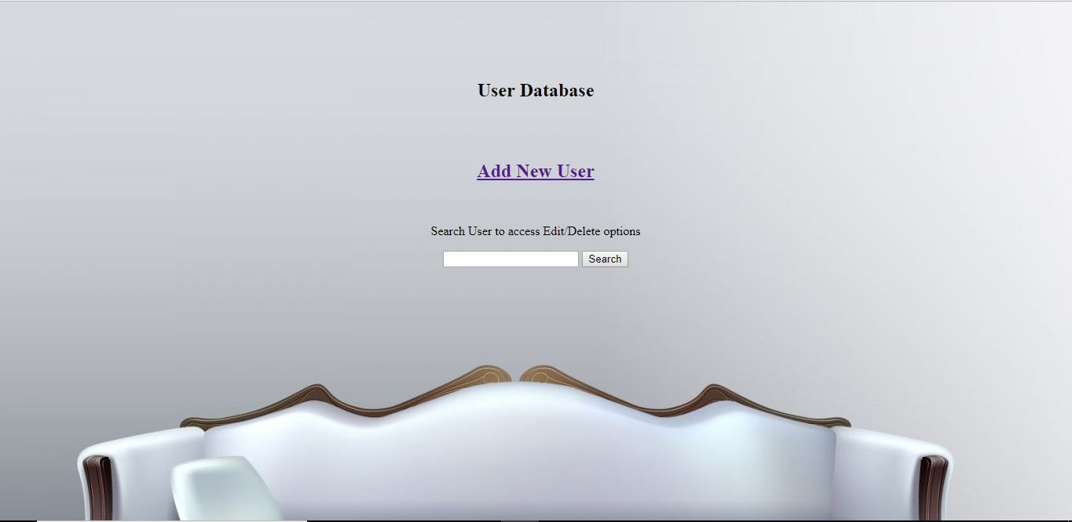
After clicking the User Database button

Slide 4
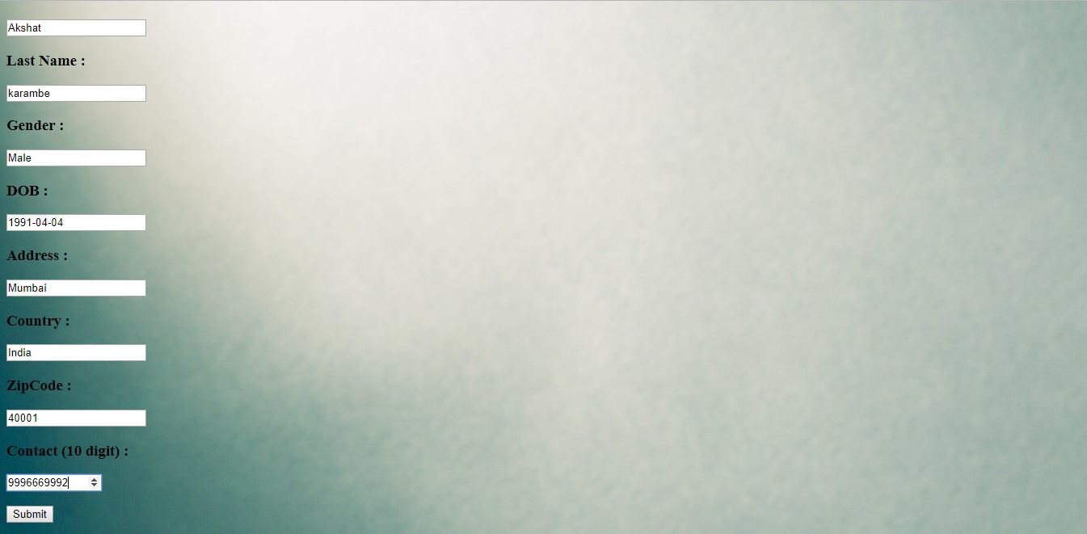
After clicking the Add New User button

Slide 5
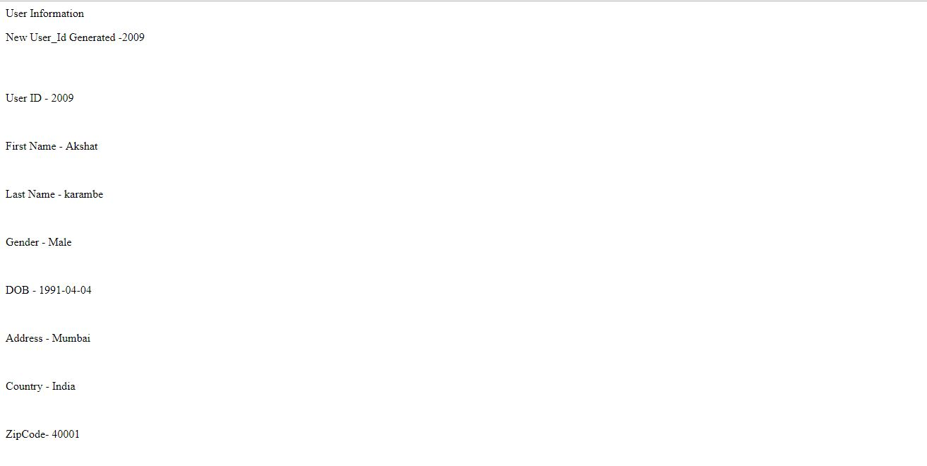
Front end page showing the user is added and the User Id is Auto Incremented to 2009

Slide 6
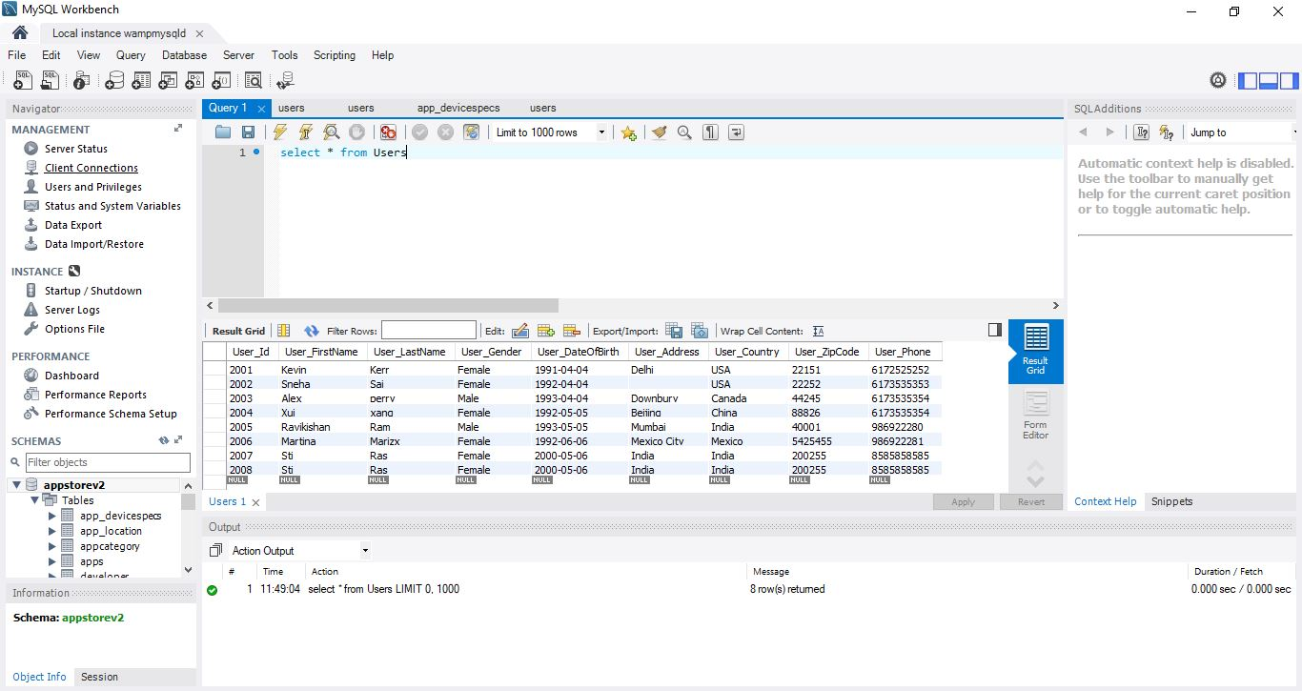
Last entry before adding the user at the backend

Slide 7
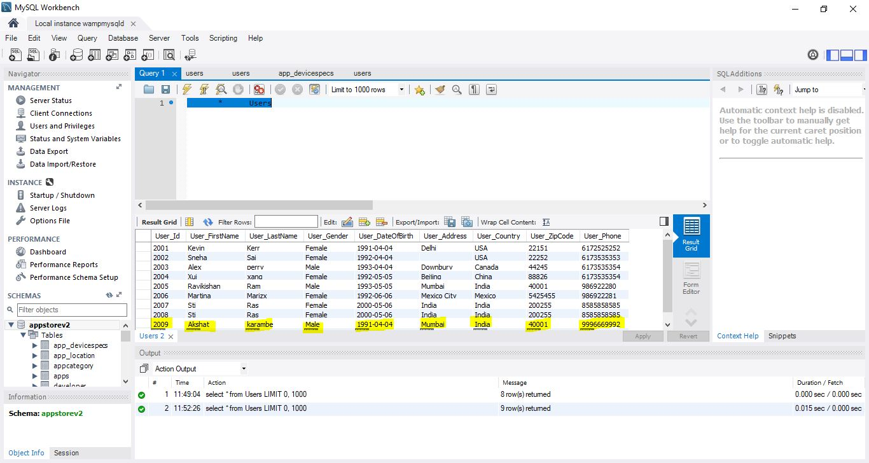
Backend database showing the user is added and the User Id is Auto Incremented to 2009

Slide 8
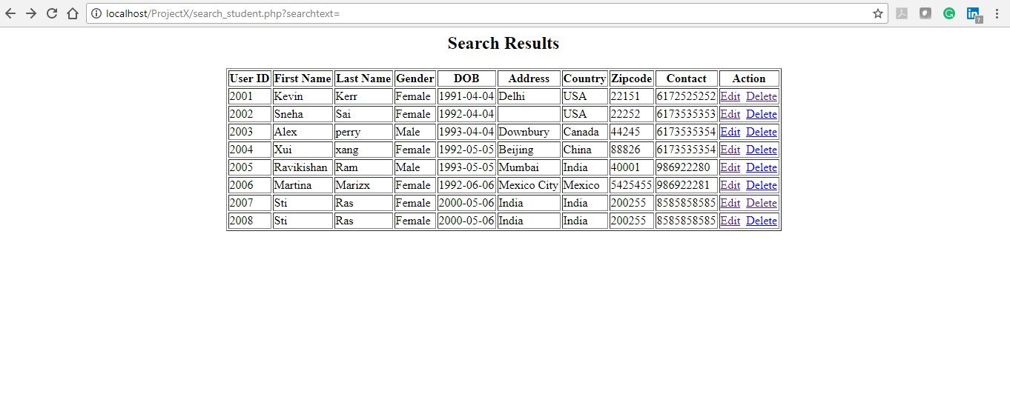
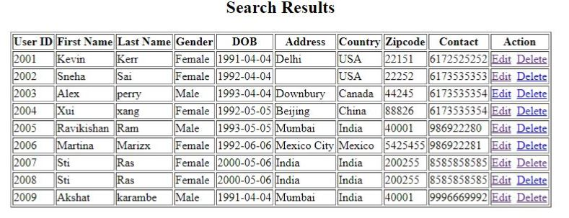
After Clicking on the Search Button on the User Database Page

Slide 9
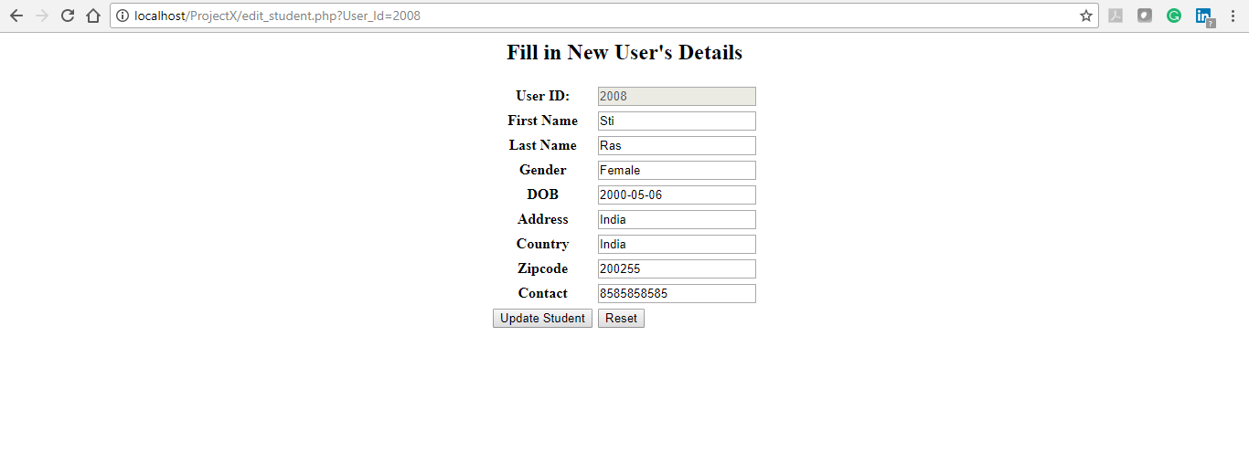
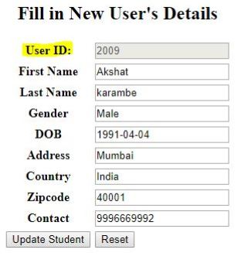
After clicking on the edit button, we can see that the apart from the User Id everything can be edited

Slide 10
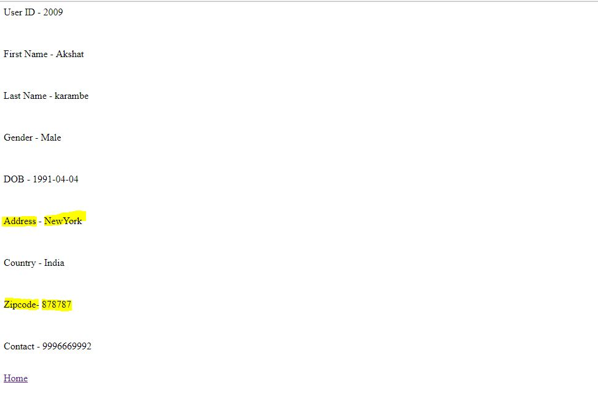
Front end page showing that the users address and ZipCode has been updated

Slide 11
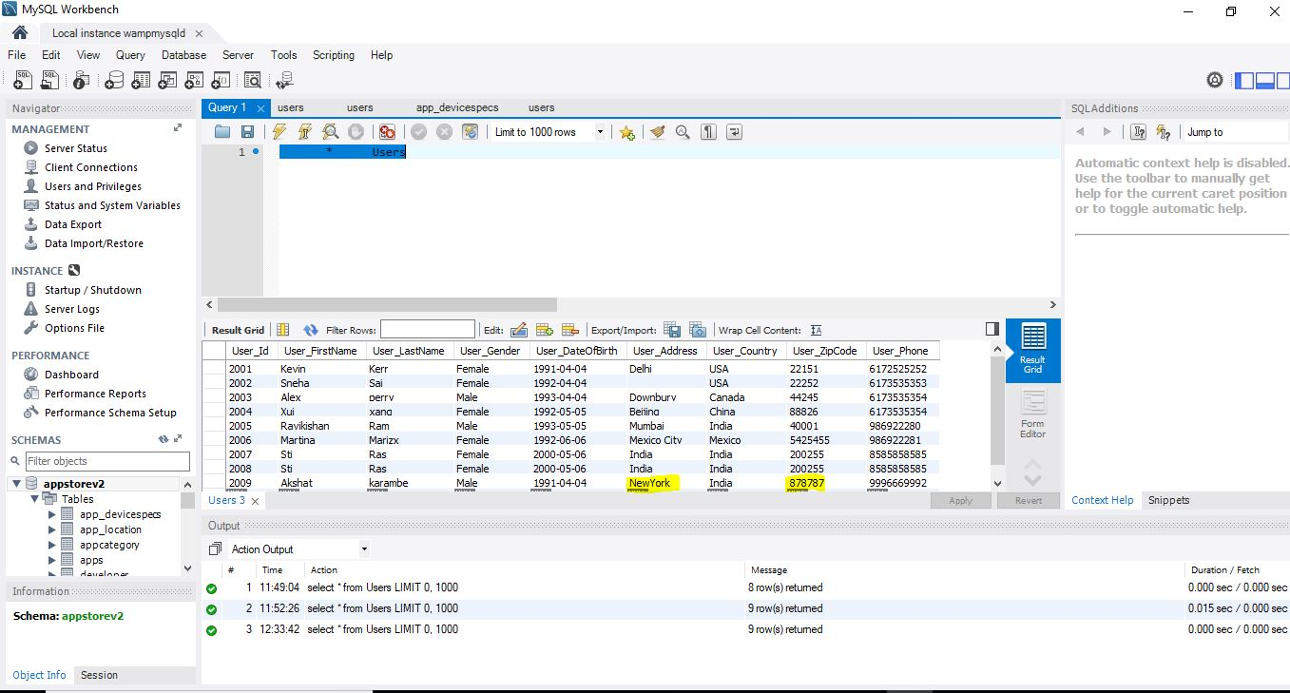
The updated Address and Zipcode reflecting at the backend

Slide 12
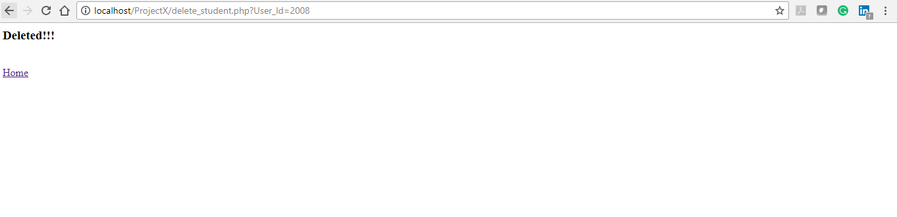
After deleting a user from the front end.

Slide 13
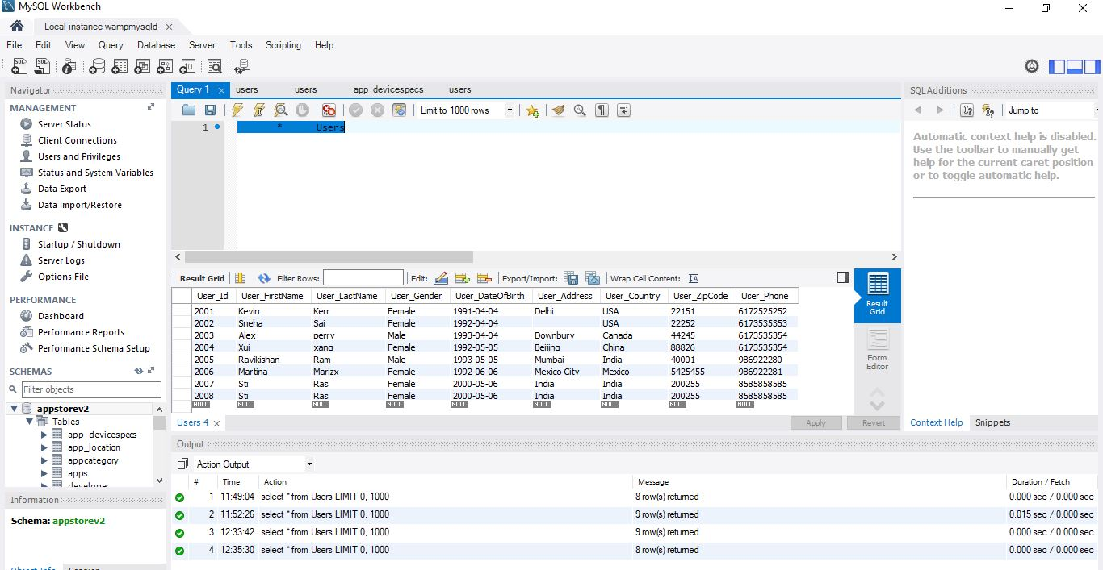
After deleting the user from the front end the user with the user id 2009 got deleted

Slide 14
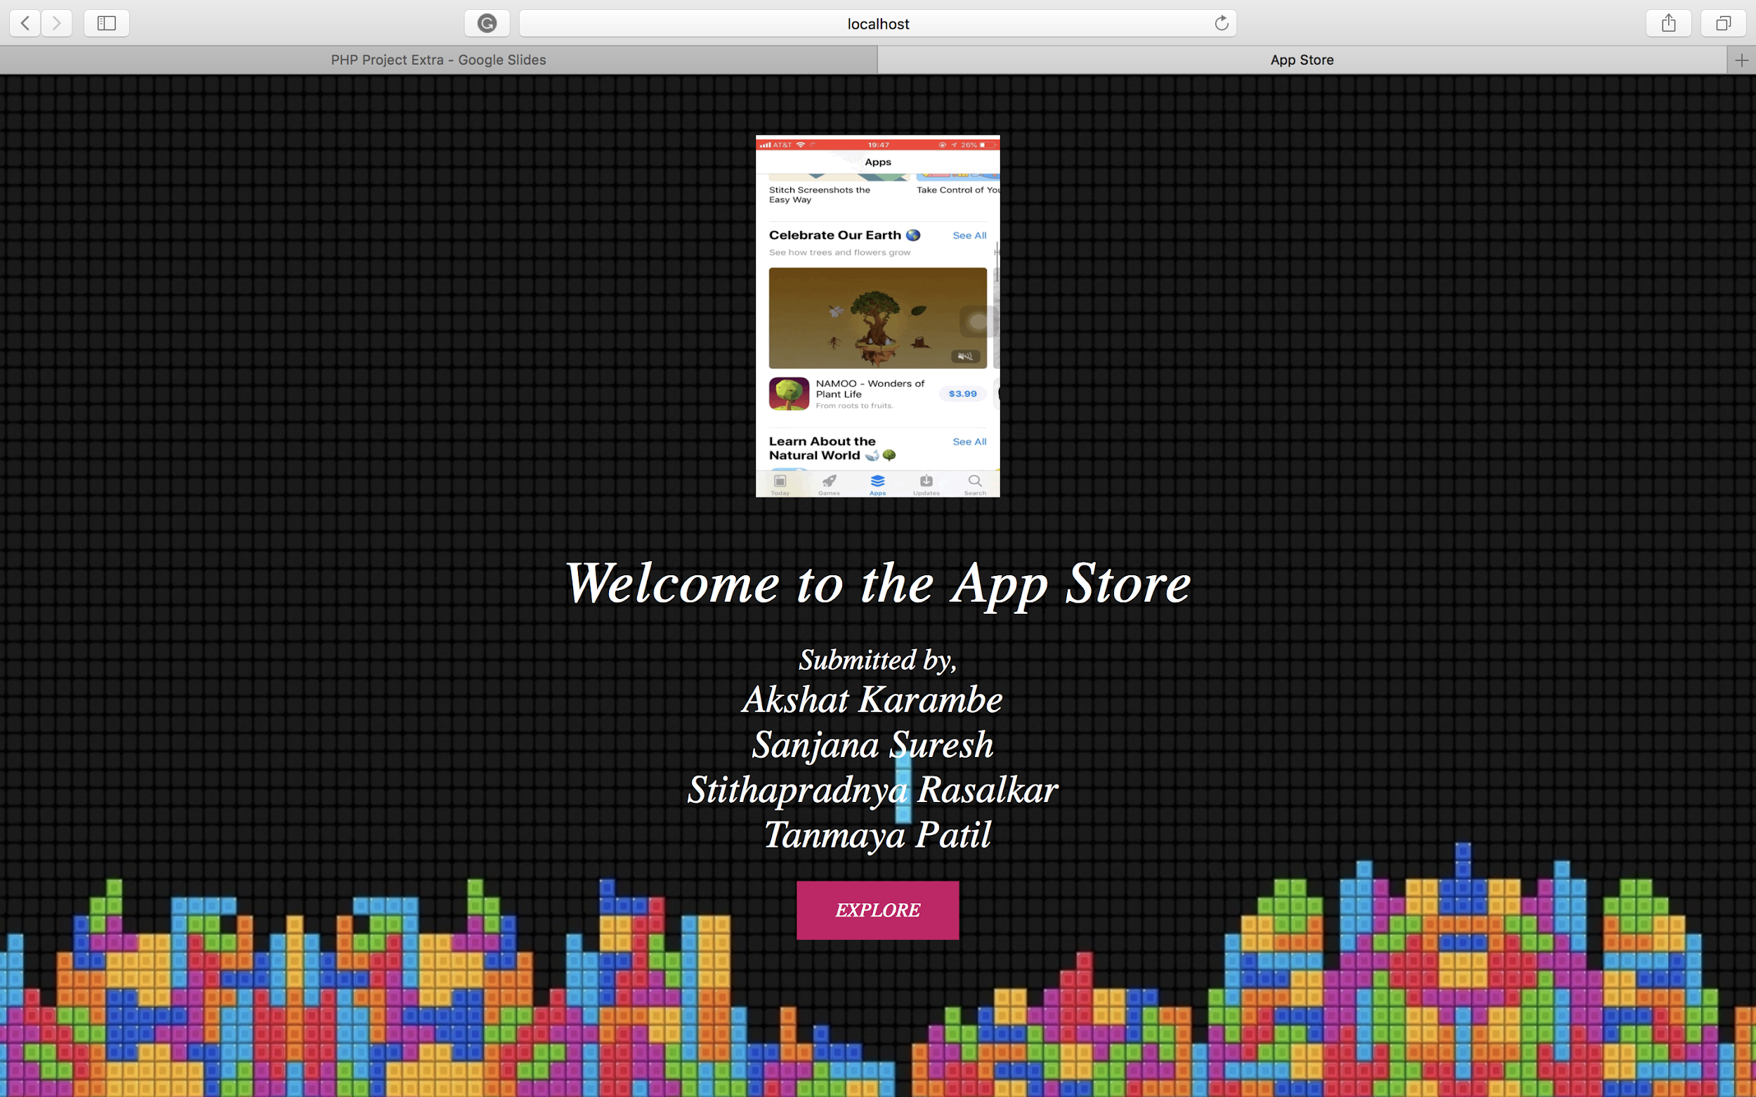
PHP PROJECT EXTRA

Slide 15
NOTE
Basic and Extra credit, both work are done on each team member’s system
Base is little different because we tried to implement our own app store model
UI and screenshots are from 4 different base models.

Slide 16
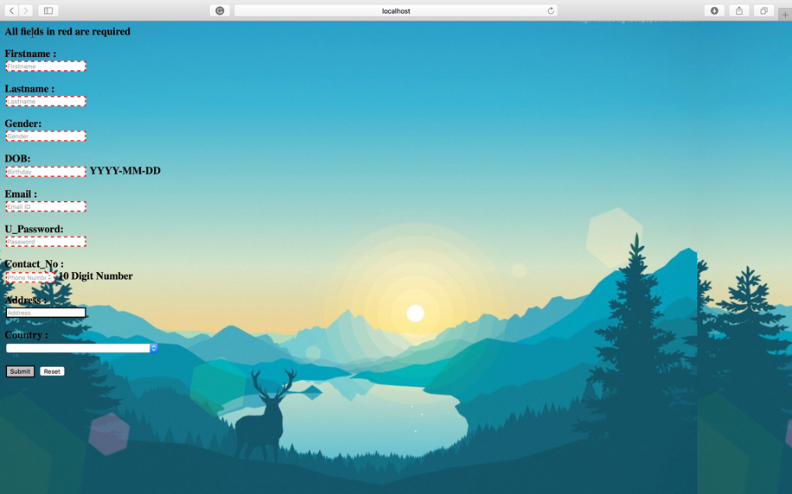

ADD USER-SCREENSHOTS
All the red boxes are the ones which are mandatory.
Placeholders have been added in the boxes.
The firstname and lastname boxes are still red because the format is not matching. User has to add alphabets only.

Slide 17
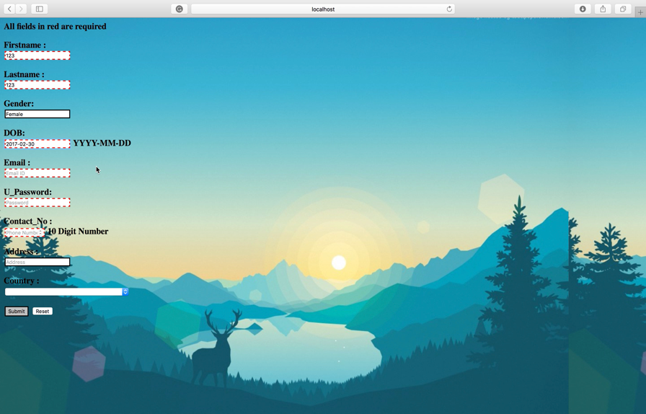
ADD USER-SCREENSHOTS
The date has been given a format where it Checks for the following condition
1) the year is numeric and starts with 19xx or 20xx,
2) the month is numeric and between 01-12, and
3) the day is numeric between 01-29, or
a) 30 if the month value is anything other than 02, or
b) 31 if the month value is one of 01,03,05,07,08,10, or 12.
In the below screenshot, the date given is 2017-02-30 which is not valid and hence the red box.

Slide 18

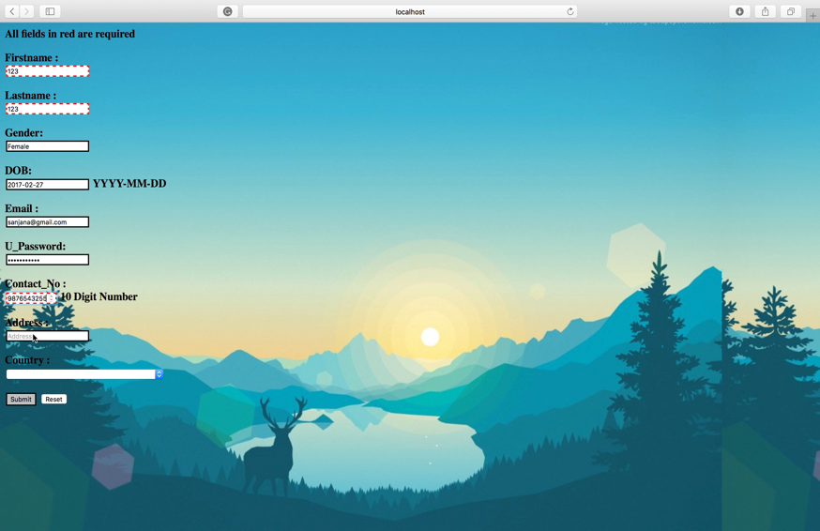
ADD USER-SCREENSHOTS
The email box is still red because the format is email@email.com which is not matching.
Since the contact_no field has more than 10 numbers, it is still red.

Slide 19
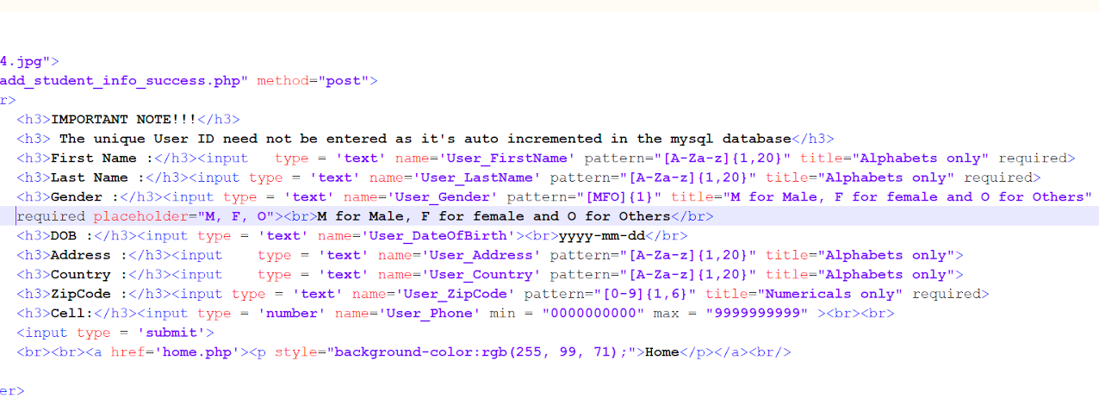
Input Validation for all the field on the PHP
Placeholders, Phone no. limit to 10digits, First name accepts only alphabets, The name field should be atleast 1 character and max of 20.

Slide 20
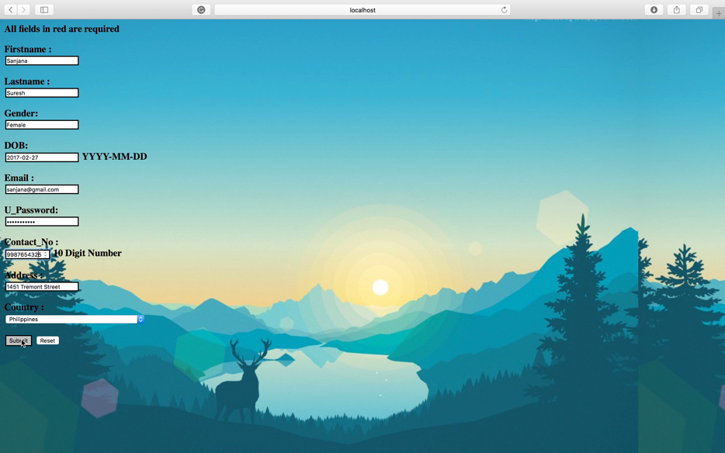
ADD USER-SCREENSHOTS
Once the contact number field has 10 digits it turns black

Slide 21
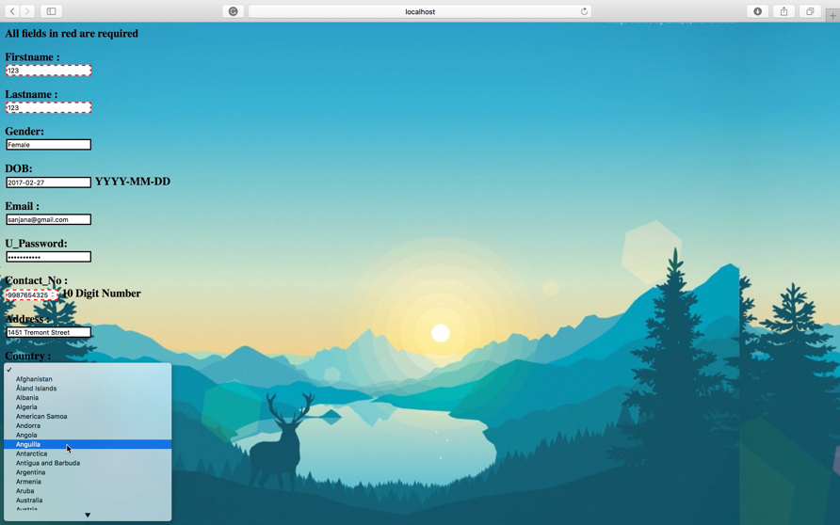
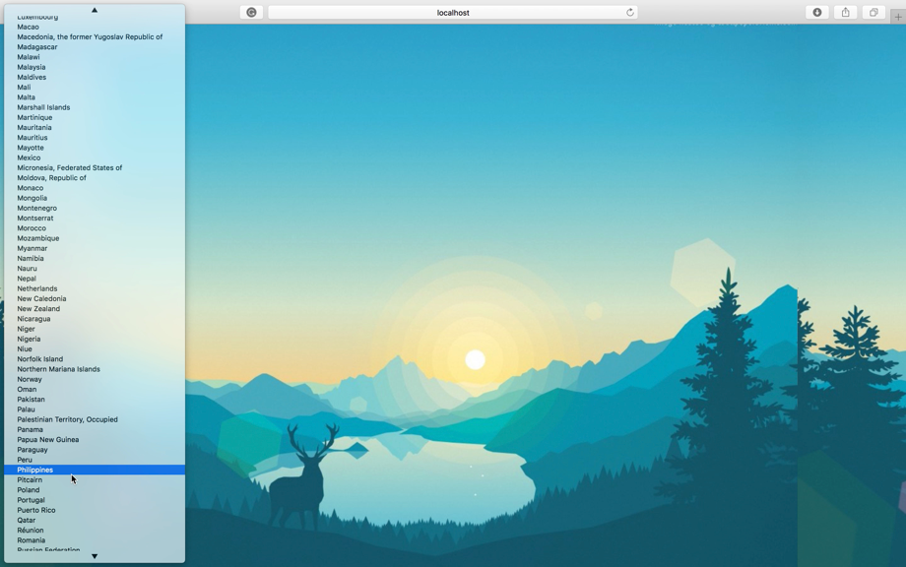
ADD USER-SCREENSHOTS
Drop down has been added for the list of countries.

Slide 22

ADD USER-SCREENSHOTS

Slide 23
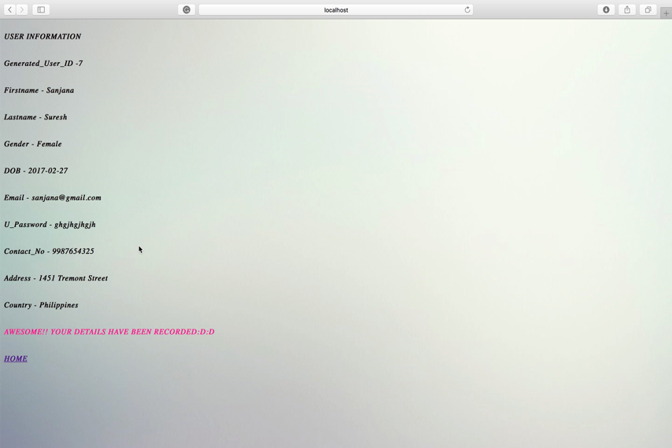
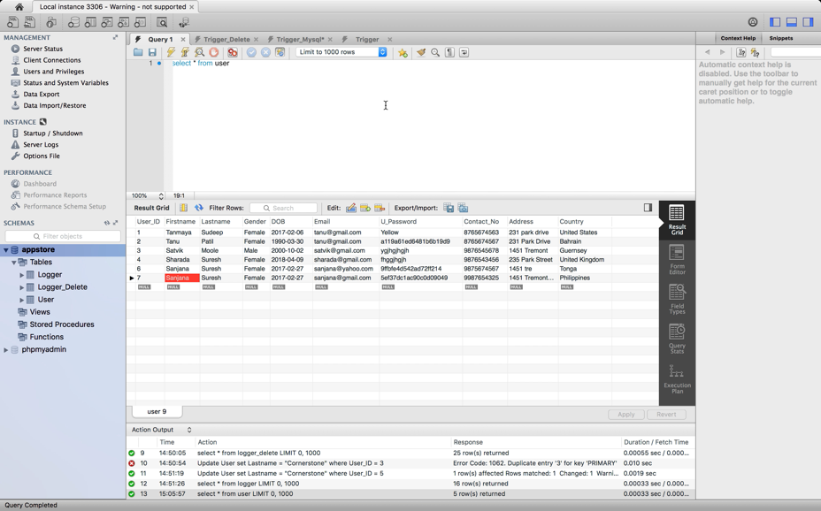
USER HAS BEEN ADDED TO THE DATABASE
Database is refreshed and the new user has been added.
Once the form has been submitted it is redirected to the below page with summary of entered details

Slide 24
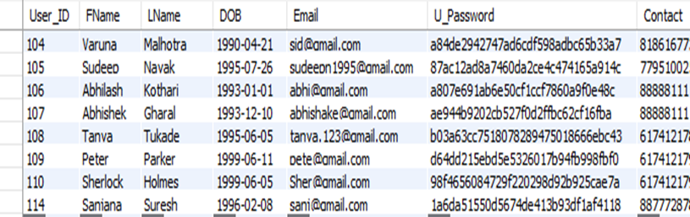
PASSWORD ENCRYPTION HAS BEEN DONE IN BACK END (DATABASE)

Slide 25
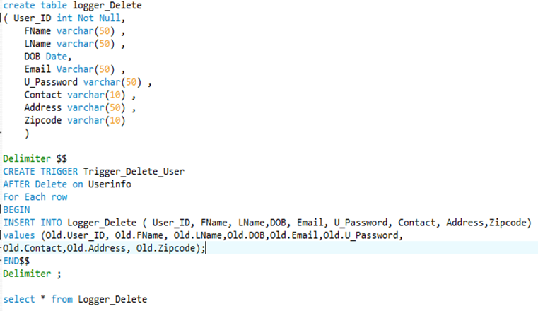
TRIGGER ON DELETE
Whenever the user is deleted from the ass store database, the entire info is recorded into a seperate log table for later reference,

Slide 26
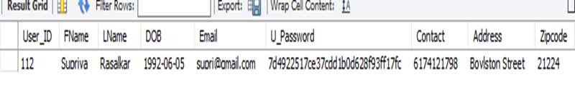
RESULTS

Slide 27
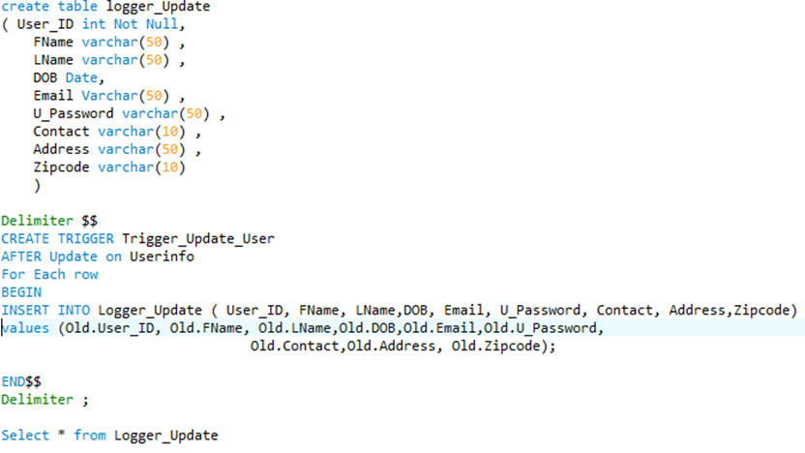
TRIGGER ON UPDATE
Whenever the user is Updated/Edited from the ass store database, the entire info is recorded into a seperate log table for later reference,

Slide 28
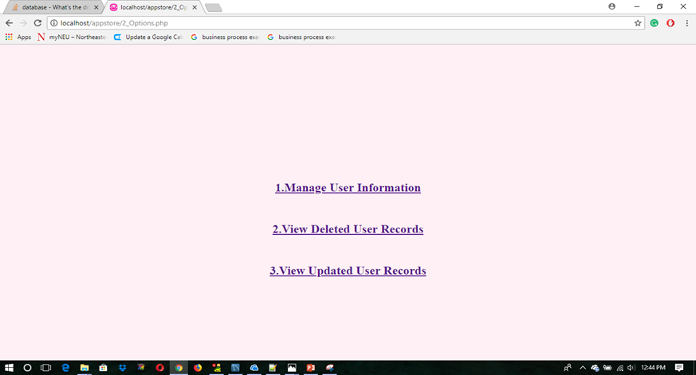
EXTRA ON FRONT END: UPDATE AND DELETE LOGGERS

Slide 29
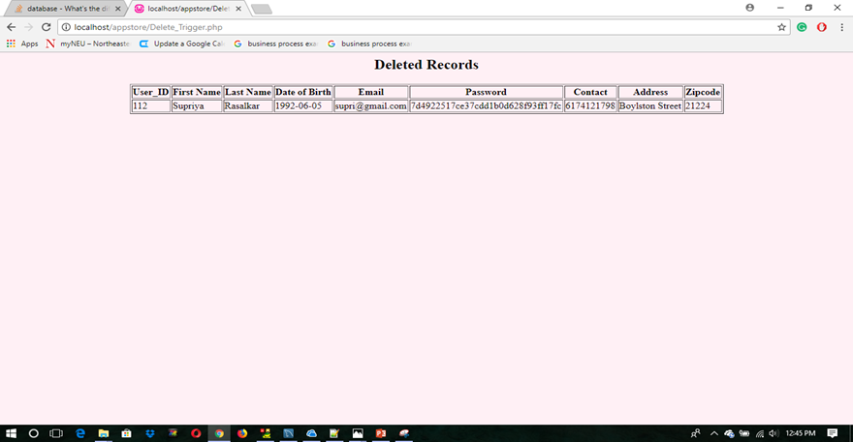
LOGGER FOR DELETED RECORDS

Slide 30
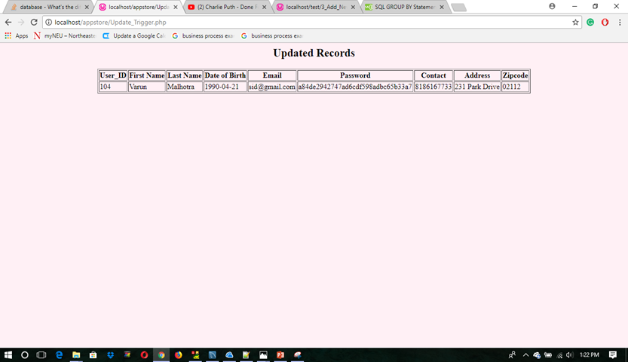
LOGGER FOR UPDATED RECORDS

Slide 31
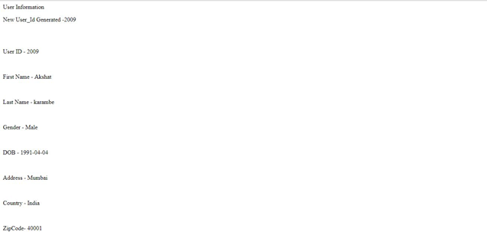
FRONT END SHOWING USER ID HAS BEEN AUTO INCREMENTED TO 2009

Slide 32

BACK END SHOWING NEW USER BEING ADDED AND USER ID BEING INCREMENTED TO 2009

Slide 33
AFTER CLICKING ON THE EDIT BUTTON, WE CAN SEE THAT EVERYTHING EXCEPT USER ID CAN BE EDITED

Slide 34
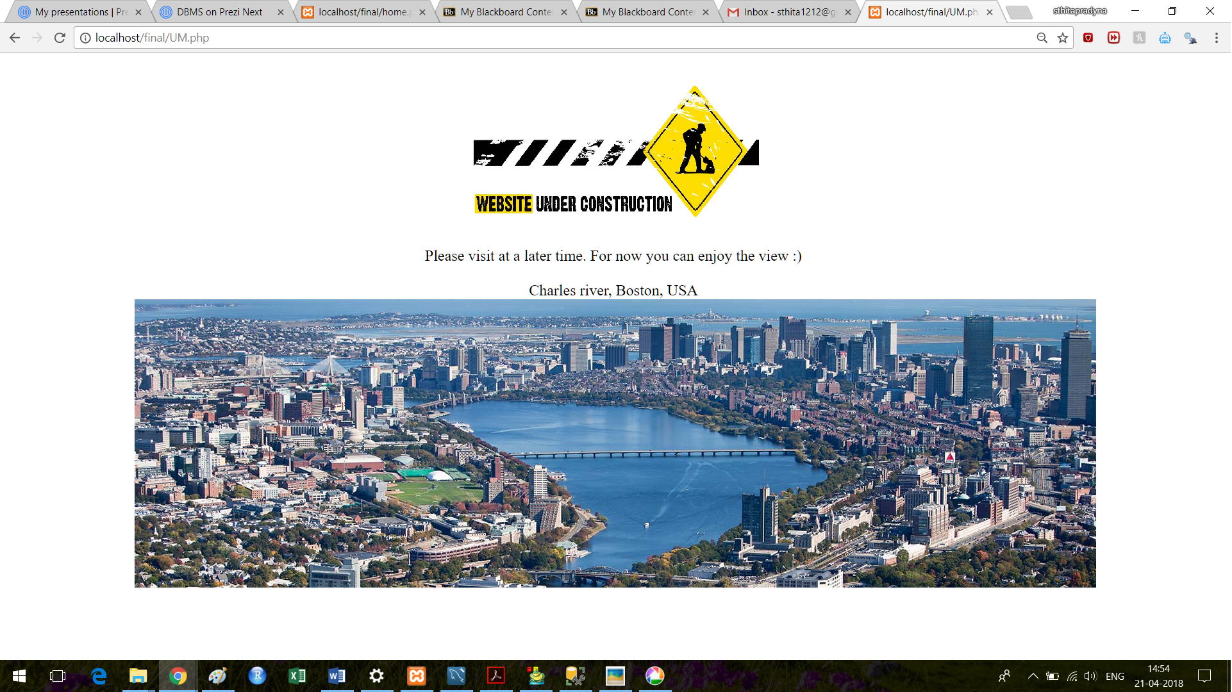
Thank you

